Slide 1
Low Carbon Lunch!
Carbon Dioxide, CO2

Slide 2
WHAT’S FOR LUNCH TODAY????

Slide 3
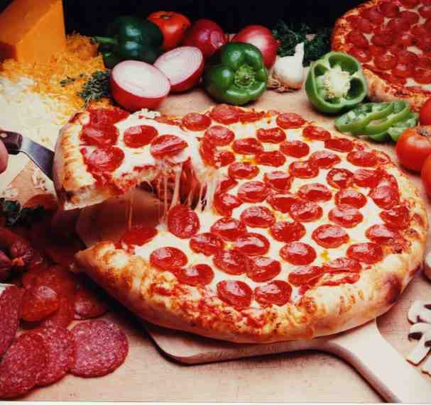
Mmmm…tasty!!! Right??

Slide 4
You already know…
That carbon dioxide is released into the air during respiration, photosynthesis (how plants make food), combustion of fossil fuels and decay of matter.
BUT…!

Slide 5
Did you know???
That pepperoni pizza contains 1208 units of carbon dioxide
And a common fast food lunch like cheese burgers and fries contains 2948 units of carbon dioxide.

Slide 6
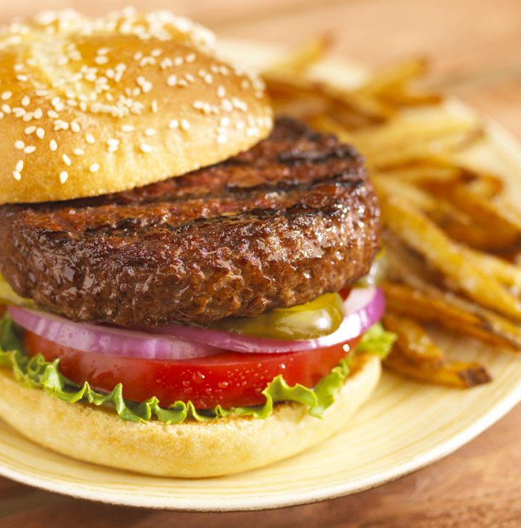
NO HARM RIGHT?…just food!

Slide 7
All we are concerned about is how the food taste but many of us don’t know that the food we eat on a daily basis contributes a lot to the carbon dioxide emissions.

Slide 8
Many of the processes to make the food we love add carbon dioxide to the air. Just to make that tasty pizza, takes a lot of work AND transportation,

Slide 9
Just THINK!!!!
The vegies you put on your pizza are NOT properly grown. They have been treated with herbicides, insectides and fertilizers to make them grow faster and bigger.

Slide 10
Still Tasty????

Slide 11
Worse????
The meat on your pizza is NOT 100% REAL. Yes, there is a SPRINKLE of REAL meat in your salami BUT the rest is just fillers and LEFT OVER SCRAPS.

Slide 12
That’s what YOU eat!!!!

Slide 13
So……next time you’re ready for lunch follow these steps:
1) Go Local- trucks and containers emit alot of carbon dioxide into the air. Try going to the market in stead of PRICESMART.
2)Get in touch with the season- try to use vegies and fruits that are in season and NOT hothouse.

Slide 14
And……
3)Easy on the animals- try to stay away from meat. Think about it you’ll be saving a cow!!!
4)Green steaming- steaming begies retains more vitamins and uses less energy and water than boiling.

Slide 15
Also……
5)Shun the machine- say no to processed and packaged foods and GO FRESH
6)Rot ON!- carry food waste to a green cone and NOT to landfills where it can release methane!

Slide 16
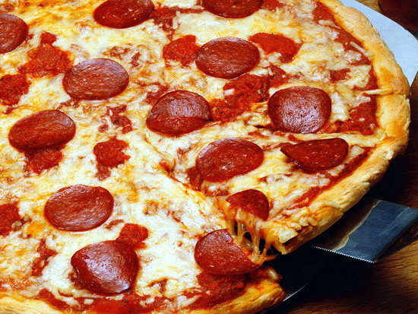
PIZZA ANYONE???

Slide 17
DONE BY
Shenyce John
Nuriyah Ibrahim
Sonya-Lee Ryan
Cheneisse Simmons

